Slide 1
CS2033a/b Multimedia and Communications II Lecture 11 E-Commerce
Vivi Tryphonopoulos

Slide 2
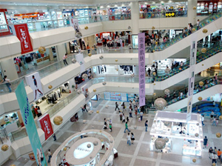
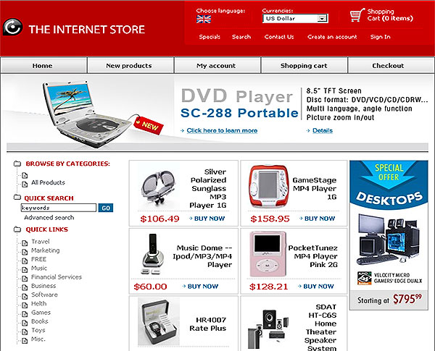
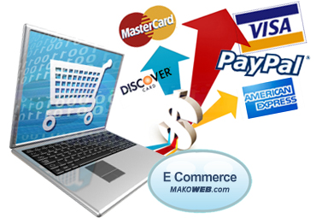
E-commerce
What is E-commerce?
= Electronic Commerce
Any type of business, or commercial transaction that involves the transfer of information across the internet.
Online shopping – buying and selling goods/services on Internet
Electronic Payments – mechanism to pay online
Notes:
Transfer of funds

Slide 3
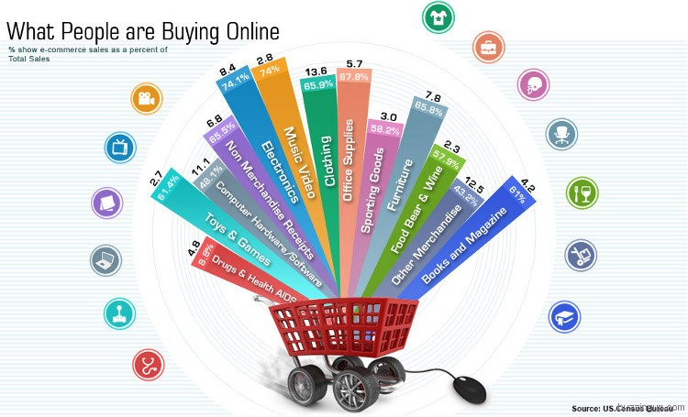
E-commerce
E-commerce businesses sell:
Physical Goods: ie books, gadgets, furniture, appliances (shipping involved)
Digital Goods: ie. software, ebooks, musc, text, images, video etc. (immediate download)
Services: tickets, insurance etc. (ecopies)
It is estimated that the United States will spend an estimated 327 Billion Dollars online in 2016.
Notes:
Available since 1996, but browser support was not there. With advent of CSS 2.0, and IE 6 Netsape 6+ Opera 6+), it has been more practical to use style sheets.

Slide 4
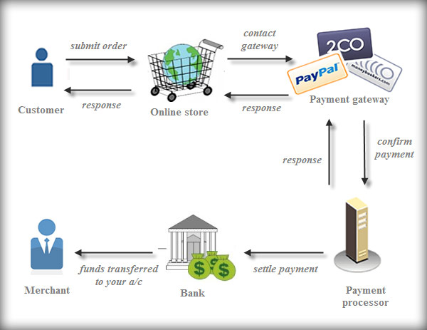
The Cycle of E-Commerce

Slide 5
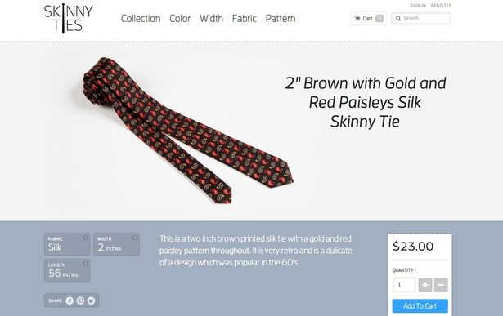
Examples of E-commerce
Purchasing Products
Online Auctions – internet auctions reaches more buyers/sellers
Internet Banking – banking operations without physical visit needed
Online Ticketing – Air tickets, movie tickets, train tickets, sporting events
http://skinnyties.com/
Notes:
Available since 1996, but browser support was not there. With advent of CSS 2.0, and IE 6 Netsape 6+ Opera 6+), it has been more practical to use style sheets.

Slide 6
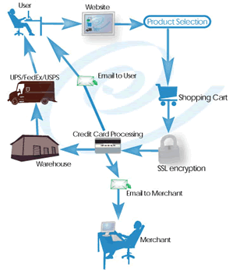
Advantages of E-commerce
“Holy grail of retail”
FOR Business
No geographic limitations - mobile
Gain new customers with search engine visibility
Lower Costs
Discount prices to consumer
Advertising and Marketing
Personnel – automated checkout, billing payments, inventory management
Lower # of employees
No realestate overhead
Offer deals, bargains, coupons
Offer larger catalogs
Deal better with change of cost dynamics
Notes:
Available since 1996, but browser support was not there. With advent of CSS 2.0, and IE 6 Netsape 6+ Opera 6+), it has been more practical to use style sheets.

Slide 7
Advantages of E-commerce
“Holy grail of retail”
For Customer
Eliminate Travel Time and Cost
Easy
Comparison Shopping
Locate Product/Review
Lower buying costs
Coupons
Notes:
Available since 1996, but browser support was not there. With advent of CSS 2.0, and IE 6 Netsape 6+ Opera 6+), it has been more practical to use style sheets.

Slide 8


E-commerce
Disadvantages of E-commerce
Lacks Personal touch
E-commerce Delays Some Goods – unless digital goods: ebook or music file download.
Product Experience
Cannot experience the product before purchase
Security: Consumer needs to trust the site they are buying from – credit card
Harvest of other information: Companies ask information about behaviour and preferences
Notes:
Available since 1996, but browser support was not there. With advent of CSS 2.0, and IE 6 Netsape 6+ Opera 6+), it has been more practical to use style sheets.

Slide 9
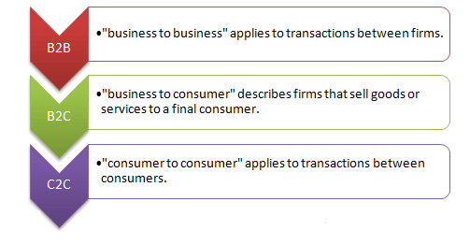
E-commerce
Types of E-commerce:
All transactions fall into one of these categories:
Business to Business (B2B)
Both transacting parties are businesses ie. manufacturers, traders, retailers etc.
Business to Consumer (B2C)
Businesses sell electronically to end-consumers
Consumer to Consumer (C2C)
Between consumers
A bartering system – auction sites
It is an online platform where anyone can put products on sale without any middleman, to be bought by any end consumer
Question: kijiji is not a C2C – Why? No online Payment
Notes:
Available since 1996, but browser support was not there. With advent of CSS 2.0, and IE 6 Netsape 6+ Opera 6+), it has been more practical to use style sheets.

Slide 10
E-commerce
Business to Business (B2B)
Both transacting parties are businesses
Ie. such as between a manufacturer and a wholesaler, or between a wholesaler and a retailer.
B2B site deals primarily with other businesses, not the general public
B2B sites normally handle a lot more than just sales of products, they are a portal to conduct business transactions.
allow businesses to deal directly with their suppliers and distributors online.
Business to Consumer (B2C)
Businesses sell electronically to end-consumers
a B2C site sells directly to the end user.
Typically these are sites like Amazon, online book retailers, lastminute.com, a "good times" portal.
These sites are more interested in passing the goods to the end user.
B2C websites are also intermediary portals to link customers to suppliers
Ie. of the major ones are ebay, an auction site. Yell, an internet version of yellow pages and ZDNet a technology market place. All of these businesses exist primarily on the internet. They are what is known as e-businesses (electronic businesses
classified under one general heading, market places
Notes:
Available since 1996, but browser support was not there. With advent of CSS 2.0, and IE 6 Netsape 6+ Opera 6+), it has been more practical to use style sheets.

Slide 11
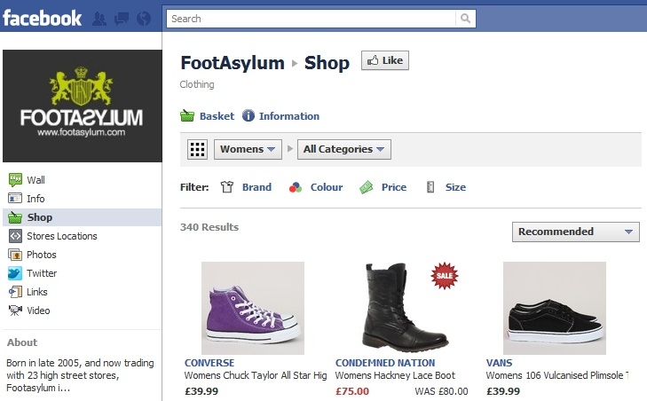
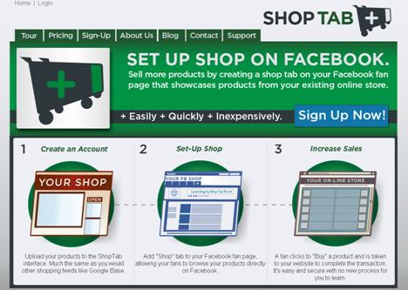
E-commerce
Specialized forms of E-commerce:
F-commerce
Facebook commerce
Buying and selling through Facebook
Belief: captive audience
Actually: not sold on idea
M-commerce
Mobile commerce
Delivery of electronic commerce capabilities directly into consumer’s hand, anywhere, via wireless technology
Walmart estimated that 40% of all visits to their internet shopping site in Dec. 2013 was from mobile device.
→ popularity leading to new transactions
Notes:
Available since 1996, but browser support was not there. With advent of CSS 2.0, and IE 6 Netsape 6+ Opera 6+), it has been more practical to use style sheets.

Slide 12
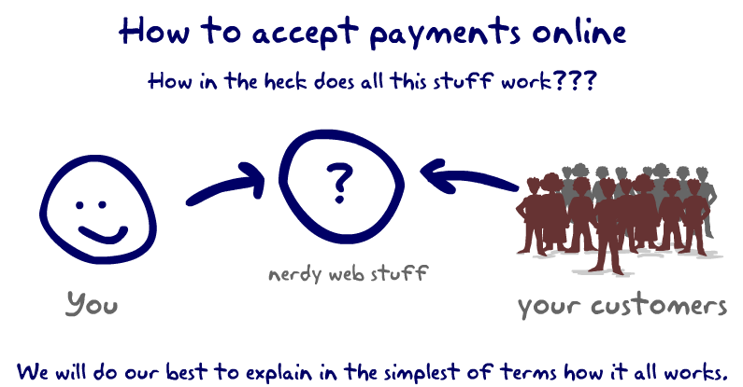
How to Get started with an online store?
You need a website that you build using Dreamweaver or Wordpress
Or Go with a third party software that does it all for you Ie. Shopify, Volusion or Giving Fuel
http://givingfuel.com/understanding-payments-online

Slide 13
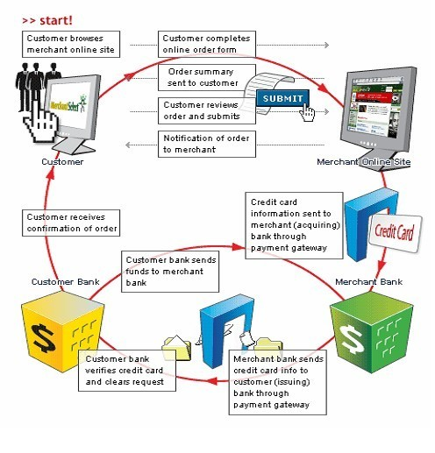
E-commerce
How to Get started with an online store?
Intent that you are selling a product/service
Need e-commerce enabled website
Shopping cart software allows consumers to:
Purchase goods or services, enter and keep up orders
Track customers
A merchant account:
Accepting online payments - collect
accepting credit cards through an online payment gateway
A payment gateway
is an e-commerce service that authorizes payments for e-businesses and online retailers.
Notes:
Available since 1996, but browser support was not there. With advent of CSS 2.0, and IE 6 Netsape 6+ Opera 6+), it has been more practical to use style sheets.

Slide 14
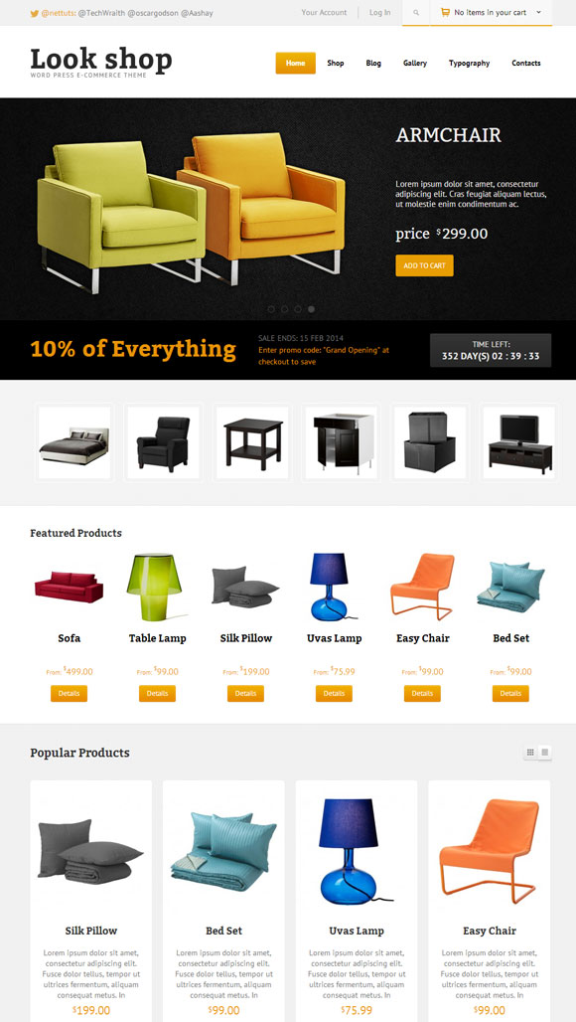
E-commerce
Building Blocks of a Good E-commerce Website Definite things to include:
Product Description – compelling → sale
Images – visual appeal, different views, models
Upfront Pricing – upfront ie. shipping, taxes, giftwrapping
Payment Options – acceptance methods –some versatility
Shopping Cart – mandatory- accessiblity/ease
Easy to find products: internal search capabilities
Contact Info: - easy to find you
Customer Service:
Returns Policy clause
Rapid Checkout
Shipping Options
Security
Notes:
Available since 1996, but browser support was not there. With advent of CSS 2.0, and IE 6 Netsape 6+ Opera 6+), it has been more practical to use style sheets.

Slide 15
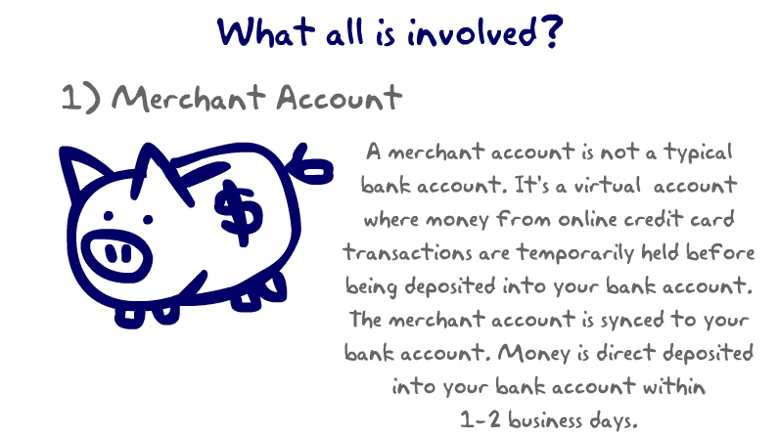
A merchant account is an agreement made between the business/seller and the bank where the merchant account is held
The fees associated with these accounts are usually done by
A flat rat per transaction ie: 30 cents per transaction
% rate of total sale.
#1 - What's Involved: A Merchant Account. Ie. Paypal
A merchant account is NOT a standard bank account
but a virtual account that acts as a middle man when credit cards and checks are charged online. Ie Paypal
Accepts online payments - collects accepting credit cards through an online payment gateway (will talk next)
Electronically synced to your bank account and will coordinate the transfer of your online transactions AND directly deposit them into your bank account automatically. within 1 to 2 business days.

Slide 16
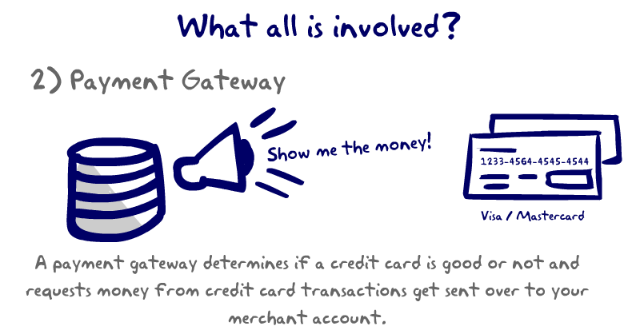
#2 - What's Involved: A Payment Gateway
is like a virtual gatekeeper that determines whether a credit card is valid.
It speaks directly with Visa, MasterCard and other bank cards to determine if the card is approved or not
It does this in a fraction of a second.
If it is approved, the gateway works with the merchant account (ie. Paypal) to go and retrieve the funds from people’s accounts and get them ready to be deposited into your bank account. Examples of Payment Gateways are Sage, Authorize.net, USAePay, Payments Gateway, etc.

Slide 17
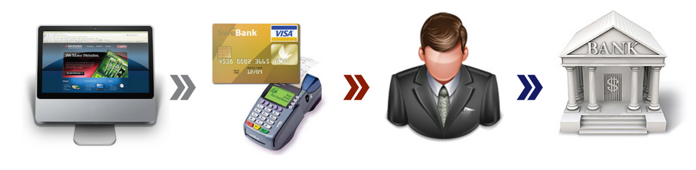
E-commerce Payment Gateway Process
Payment Gateway specific duties?
Software application that checks for:
Processing a transaction securely
Identification verification
Accept/reject transaction
Detect fraud
Process begins when visit website to make purchase Fills out form –Press Submit
After authentication and authorization, the merchant process the transaction.
Merchant sends your money to the bank
The Gateway begins the transaction authentication process
http://infogenix.com/blog/wp-content/uploads/2011/06/how_payment_gateways_work_large.jpg
Notes:
Available since 1996, but browser support was not there. With advent of CSS 2.0, and IE 6 Netsape 6+ Opera 6+), it has been more practical to use style sheets.

Slide 18
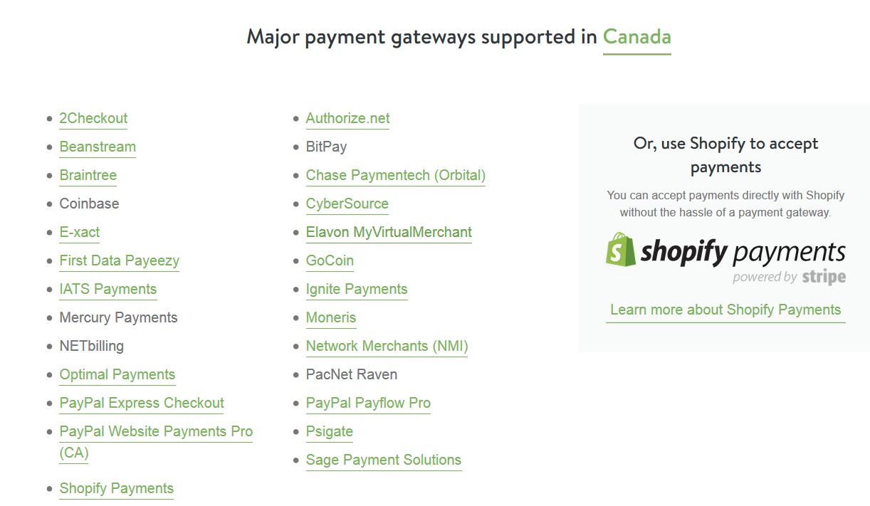

Slide 19
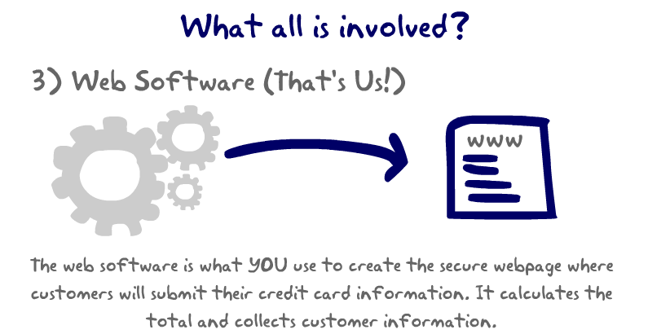
What's Involved #3: Web Software – Create Storefront (Volusion, Shopify GivingFuel,).
You need software that creates the webpage with the shopping carts/donation page where your customers will shop/donate.
The gateway orders money back and forth with Visa / Mastercard, but Using a third party (Giving Fuel or Volusion) as your software provider you create secure web pages
that can calculate a donation and collect all your donor's information.
They store and encrypt's the donor's information and then sends the money request over to the payment gateway, which tells the credit card companies to transfer money.

Slide 20
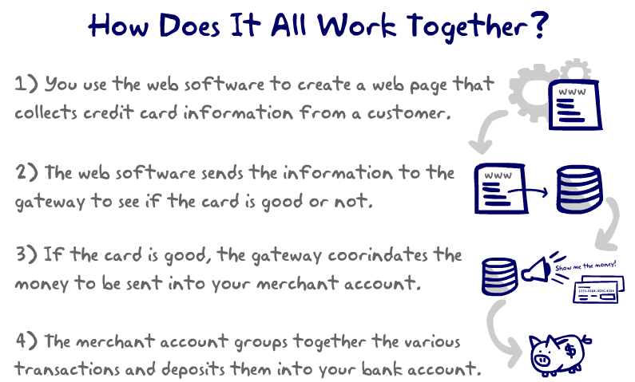
Using the web software ie. LivingFuel or Volusion, you create a secure online page that can collect donation information and credit card information.
The web software calculates the total amount of money needing to be charged and sends this information over to the payment gateway.
The payment gateway receives the information and makes sure the credit cards are good. Then it requests Visa / Mastercard to transfer money from the cardholder over to your your merchant account.
Each day, your Merchant Account will group together your Visa / Mastercard and other credit card payments and will make a direct deposit into your bank account.

Slide 21
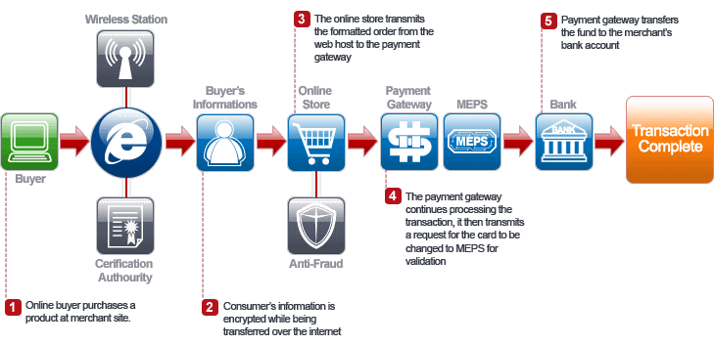
What is a Payment Gateway?
Service that authenticates and automates electronic payments made by shoppers to E-commerce merchants.
Acceptance of credit cards on websites
MEP – Malaysian Electronic Payment System
Interbank network service provider
Usually the payment gateway is bundled with your E-commerce hosting account.

Slide 22
E-commerce
Implementing E-Commerce Site
Choices are:
Enterprise Computing
Virtual hosting services
Simplified e-commerce
Flexibility Decreases
Simplicity Increases
Virtural Hosting Services
Dependent on vendor host provider
They maintain the equipment and software and sell in standardized packages ie Volusion, Giving Fuel, Shopify etc.
Includes merchant account, security, product, catalogues, etc. (as in lab 10)
Simplified E-commerce:
Small businesses uses this approach
Create your own simplified system for creating your store. Ie wordpress and build forms, shopping carts etc.
Online forms provided
Enterprise Computing (websites such as Amazon, Dell)
They purchase hardware, software
Hire their developers
To create your own e-commerce site
Applicable if:
High traffic – million visitors per month
Large catalog database
Complicated sales cycle ie. forms, pricing tables
Other businesses need to be integrated together
Notes:
Available since 1996, but browser support was not there. With advent of CSS 2.0, and IE 6 Netsape 6+ Opera 6+), it has been more practical to use style sheets.

Slide 23




E-commerce
History of E-commerce
1980s:
Directly from online CompuServe added a service called Electronic Mall
Purchase from merchants – not successful
1990: Tim Berners Lee (WWW)
1994- 1995:
Began working with processing online credit card sales
1995 (July):
Jeff Bezos boxed up the first book ever sold on Amazon from Seattle garage
Within 30 days of business – sold to online shoppers in 50 states and countries Cheap to ship, and easy to order from publishers.
Amazon.com – set standard for customer-oriented E-commerce Website.
1995: Ebay – Pierre Omidyar – broken laser pointer
Amazon.com and Ebay.com paved the way to today’s E-commerce merchant.
Notes:
NOT ON EXAM

Slide 24
And now the Review

